Slide 2
Objective: Create a Mars Habitat for the First Mars Crew
When the first human crew goes to Mars, they will be staying for at least several years. The travel alone takes six months!
They will need a habitat that can sustain them for long periods of time.
You will be designing that base. Your team will create a model and a blueprint.

Slide 3
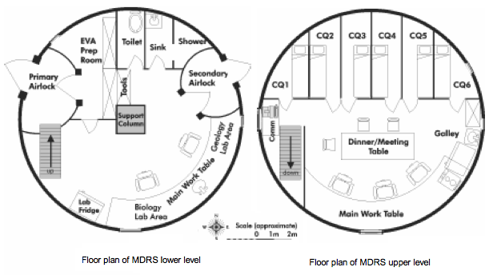
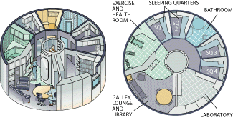
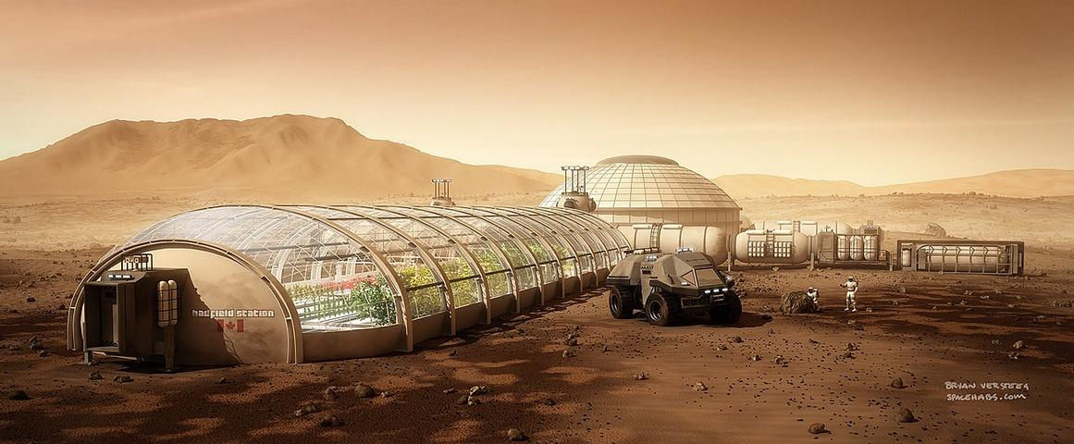
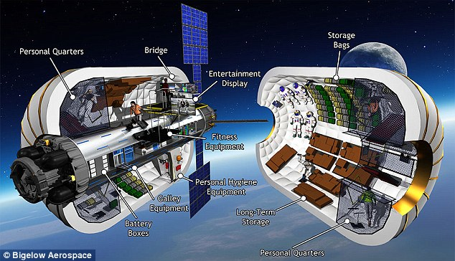
Example Habitats

Slide 4
Research
In order for a crew to be able to live on the base, there are specific components that all habitats must have.
You will be reading research briefs to determine those components.
One member of each team will read and take notes on your MARS HABITAT RESEARCH sheet.
When time is up, return to your team. Share your information and complete your research sheet.

Slide 5
Mars Habitat Criteria
Sleeping Quarters
Restroom
Exercise Room
Radiation Shielding
Food/water
Entertainment
1-2 examples of ISRU (in situ resource utilization)
Anything else your team thinks is necessary for the crew. Be creative!

Slide 6
Habitat Design
You have 30 minutes to complete your objective.
Half of your team will be drawing a blueprint of the interior of the base on your tablet.
Half of your team will be using the 3D printing pens to design the exterior of the base.
After drawing/designing, you will have 5 minutes to present your design.

Slide 7
Design Tips
Tablets:
Use the ruler button to create straight lines.
Use the curved button to help with drawing circles or arcs. You can make them bigger or smaller.
To create mirror images, click on the symmetry button next to the curved button.
3d Printing Pens:
To heat up the pen – Press the down arrow. Wait until the light turns green.
To load a color – Press the down arrow while inserting the filament.
To change colors – Press the up arrow and gently pull on the filament.
The easiest way to create a 3D structure is to make walls and attach them together.
Be careful – the tip of the 3D printing pens is HOT.

